Slide 1
Financial Analytics
In the Banking and Financial Services sector, through data analytics, institutions can monitor and assess large amounts of customer data and create personalized/customized products and services specific to individual consumers.
For example,
When a customer buys a vehicle, the bank sends promotional offers of insurance to cover the customer’s vehicle.
If a customer got a large bill, the bank could offer an EMI conversion or a loan to cover the cost.
To gain competitive advantage, banks should recognize the importance of data science, incorporate it in their decision-making process, and develop strategies based on the actionable insights from their customers data.
Start with small, doable steps to integrate data analytics into operating models and stay ahead of competition.

Slide 2
Financial Analytics Applications
Fraud Detection
Application screening
Customer acquisition & retention
Knowing customer habits
Cross-selling
Up Sell
Collections
Better cash/liquidity planning
Marketing optimization
Customer Lifetime Value (LTV)
Feedback management

Slide 3
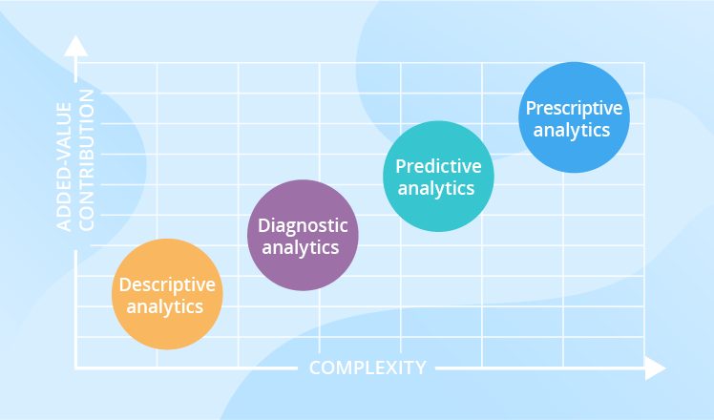
Type of Analytics

Slide 4
Types of analytics cont..
Descriptive analytics are the backbone of reporting—it's impossible to have BI tools and dashboards without it. It addresses your basic how many, when, where, and what questions. Once again, this can be further separated into two categories: ad hoc reporting and canned reports. A canned report is one that has been designed previously and contains information around a given subject. An example of this a monthly report sent by your ad agency or ad team that details performance metrics on your latest ad efforts.
Ad hoc reports, on the other hand, are designed by you and usually aren't scheduled but are more in-the-moment. They're useful for obtaining more in-depth information about a specific query.
Diagnostic data analytics is the process of examining data to understand cause and event, or why something happened. Techniques like drill-down, data discovery, data mining, and correlations are often employed.
Predictive analytics may be the most commonly used category of data analytics as it is used to identify trends, correlations, and causation. The category can be further broken down into predictive modeling and statistical modeling. But, it's important to know that these two really go hand in hand.
Prescriptive analytics is where AI and big data meet to help predict outcomes and what actions to take. This category of analytics can be further broken down into optimization and random testing. Using advancements in machine learning, prescriptive analytics can help answer questions like "What if we try this?" and "What is the best action" without spending the time actually trying out each variable. Basically, it can help you test the right variables and even suggest new variables with a higher chance of generating a positive outcome.

Slide 5
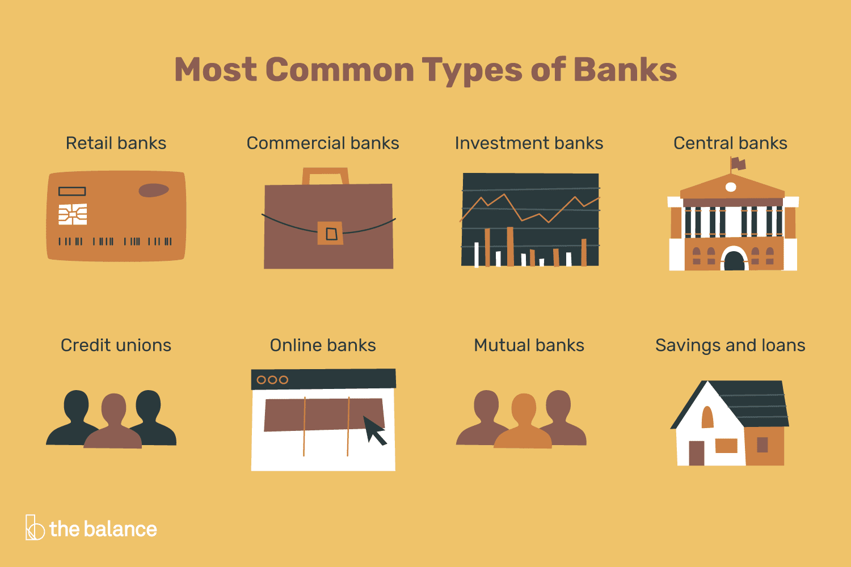
Type of Banks

Slide 6


Slide 7
Finance meets Analytics
Data Understanding
OT
Missing Values Treatment
Algorithms
Logistic
Linear
K-means
Finnancial
Analytics
Consultant
EXPERT
Finnancial Concepts
e.g. Cash Flow, Cross sell, profitablity etc.
Technical – R
Python
Syntax / Logics etc.

Slide 8
Organizations using Analytics
The 10 companies that employ the maximum number of financial analytics professionals in India are :
HSBC
American Express
ICICI Bank
Moody’s Analytics Knowledge Services
Citi
JPMorgan Chase & Co.
HDFC Bank
Axis Bank
EY
Barclays

